Slide 1
An Equilibrium Theory of the Distribution of Income and Intergenerational Mobility
Gary S. Becker
Nigel Tomes
The Journal of Political Economy, Vol.87, No.6 (Dec., 1979), 1153-1189

Slide 2
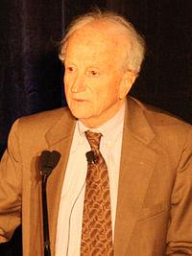
Gary S. Becker
Professor of economics and sociology, University of Chicago
the Nobel Memorial Prize in Economic Sciences, 1992
one of the first economists to branch into what were traditionally considered topics belonging to sociology
Notes:
including racial discrimination, crime, family organization, and drug addiction (see rational addiction). He is known for arguing that many different types of human behavior can be seen as rational and utility maximizing.
Nigel Tomes
Religion Family inheritance
Religion and the Earnings Function
On the Intergenerational Savings Function
The Family, Inheritance, and the Intergenerational Transmission of Inequality

Slide 3
Previous Literatures
Sociologists have emphasized the role of an individual’s forebears in the determination of his “socioeconomic” status through their influence on his back ground, class, or caste(Blau and Duncan,1967)
The economic approach to social interactions views an individual not in isolation but as part of a family whose members span several generations.(Becker and Tomes 1976)

Slide 4
Assumptions:
Each family maximizes a utility function spanning several generations
Utility(Parents’ consumption, quantity and quality of children)
Income of children(capital, endowment,market)
Human & Nonhuman capital
Race, Ability,
Family Reputation
Connection
Chance, “endowed luck”

Slide 5
Sections
Single Family
The equilibrium Inequality in Income
Intergenerational Mobility
Estimation of Family and Market Parameters
Heterogeneous Families
Government Redistribution of Income
Extensions

Slide 6
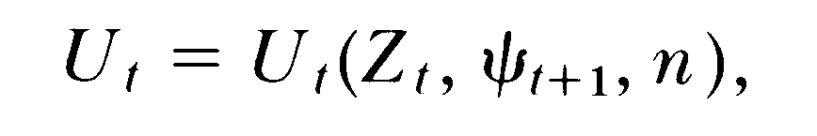


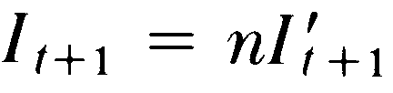


Single Family
1. Utility:
Set children identical:
Zt: Parent’s consumption, n: Number of children, Relevant charactoristics of each child, t: t-th generation
To simplify=>Total charactoristic of all the children
Adult’s wealth of each child

Slide 7


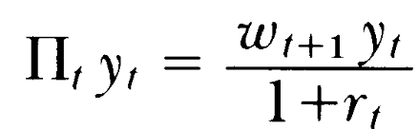


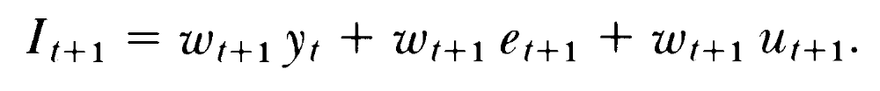


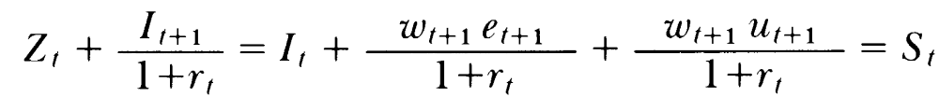
Single Family
2. Investment
BC:
yt: Total amount invested :Forgone consumption/unit of yt
Rate of Return:
: Value of capital to children/unit; : Rate of return/generation
: Endowed capital; : ”Capital gain” due to luck in the market for income
BC:
Family Inocme

Slide 8
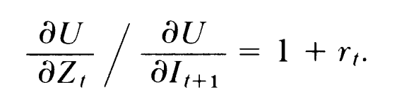
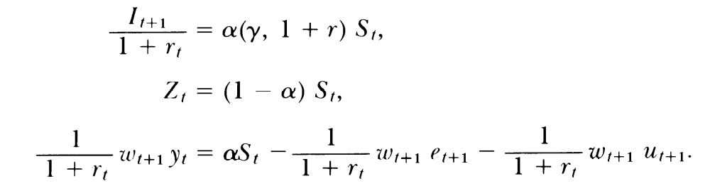

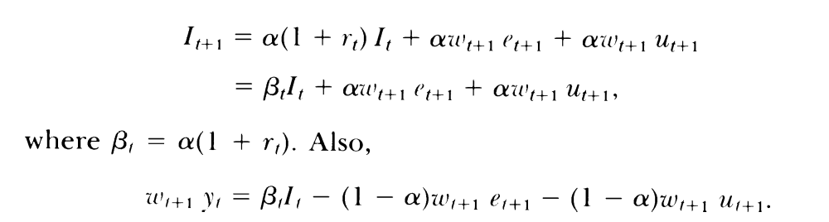
:The preference for the income of children relative to own consumption

Slide 9

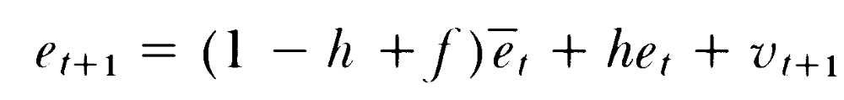

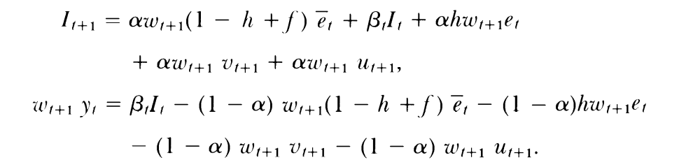
Single Family
3. Endowment
=Parent’s endowments + Average endowment in society (Simplify)
: Average endowment in generation t; f: rate of growth of ;
h: fraction of transmitted to children

Slide 10
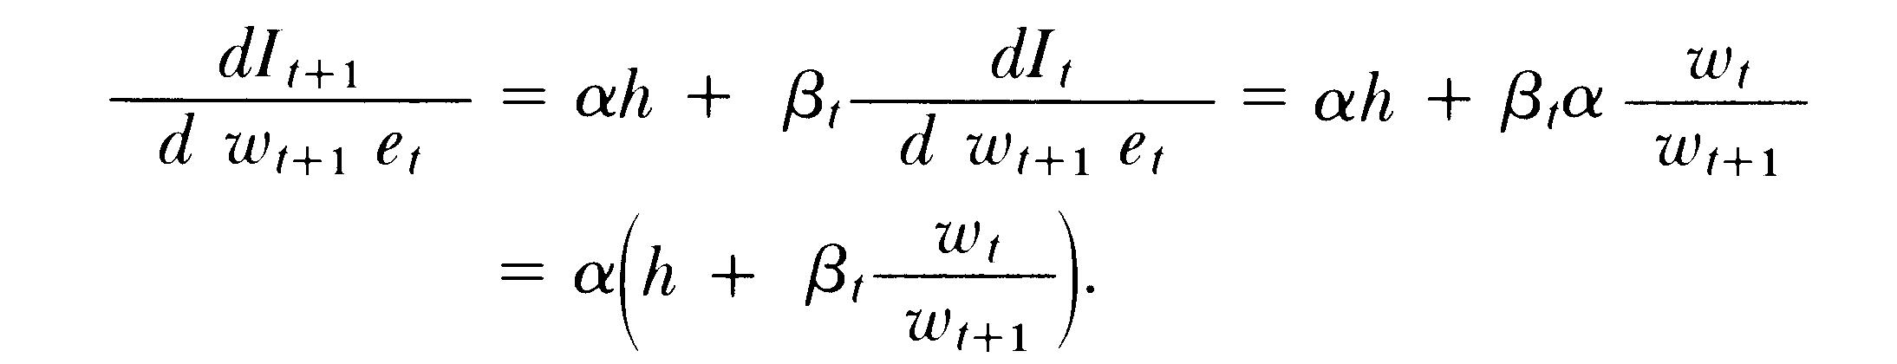
Single Family
The total effect of a change in parent endowment on the income of children:
The total effect would exceed the degree of inheritability if the fraction of family income spent on children and the propensity to invest were large relative to the degree of inheritability.

Slide 11

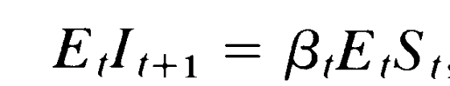
Single Family
4. Luck
Endowment luck
Market luck is determined by flunctuations of production possibilities + prices of goods + factors of production (often determined after the children grow up)
=>Expectation
Set: Parents are risk mutual; Max E(Ut)
Expected income of children:

Slide 12
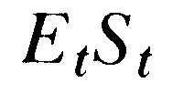

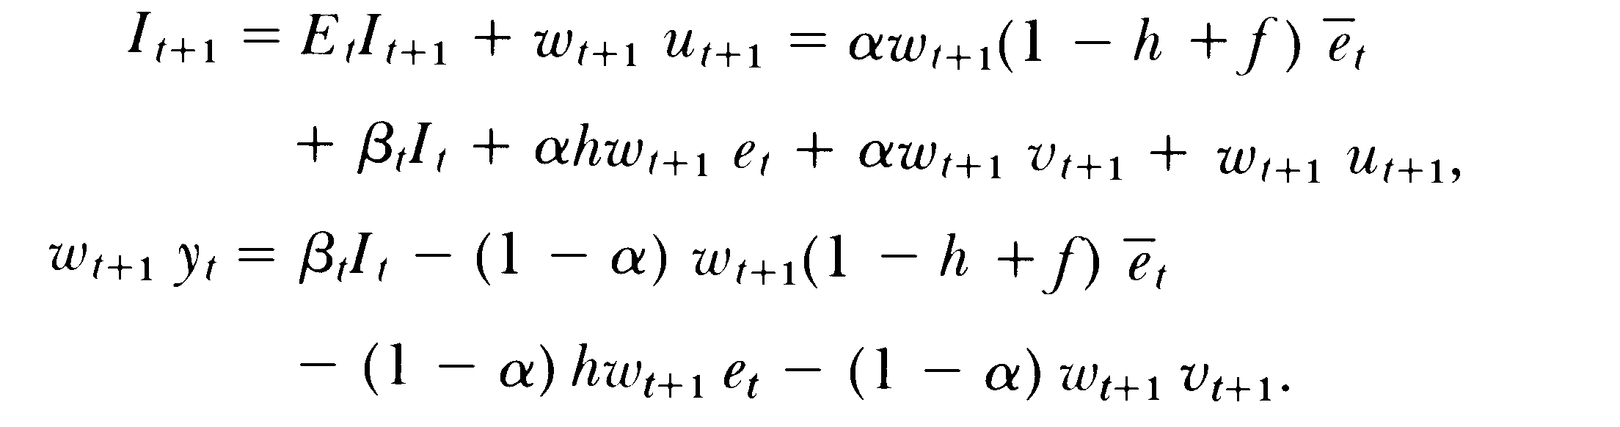
Single Family
Ut+1 cannot be anticipated
Then, children’s income & value of investment

Slide 13
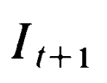
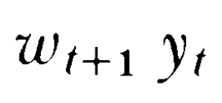
Single Family
Rate of return(PV)
Endowment
(family+society)
Parent’s Investment(Yt)
Budget Constraint
Expectation

Slide 14
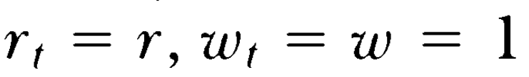
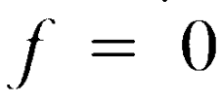
The equilibrium Inequality in Income
Even if families are identical, income can be different due to unequal incidence of endowment and market luck.
Assume all families have the same utility function, degree of inheritability and rate of return
rt, ut independent to aggregate accumulation of capital
All parameters and average endowment are stationary over time.

Slide 15

The equilibrium Inequality in Income
The income of children of the ith family in the (t+1)-th generation is:
Where

Slide 16
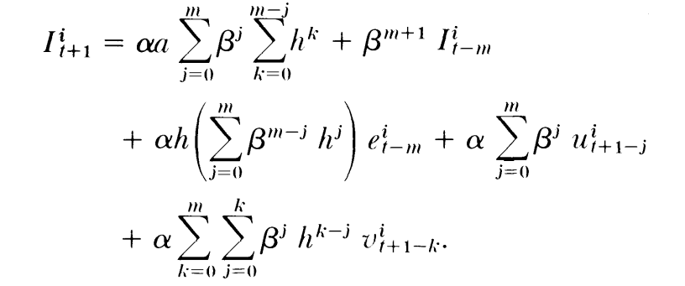
The equilibrium Inequality in Income
Assume children have the same utility function
=> Families would have the same income if they have the same luck in that and all previous generations
=>The income inequality in any generation can be expressed by the distribution of luck in all previous generations:

Slide 17
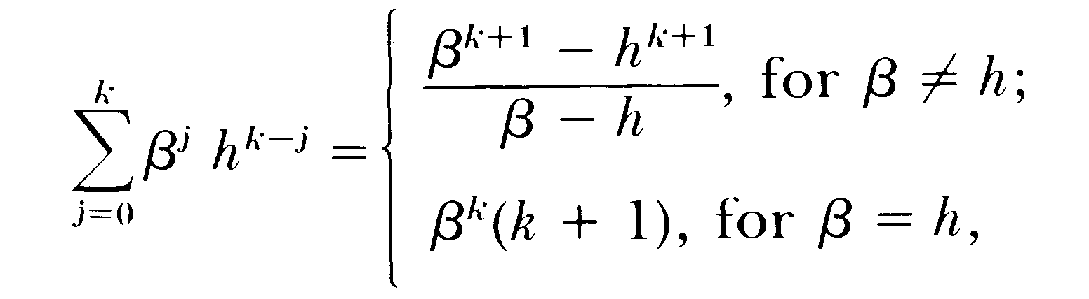
0<h<1: only part of the family endowment is passed on. r can create a sizable percent of increase per generation. => βmight be greater than 1
Assumeβ=α(1+r)<1
Extend them back through infinately many generations:
The income of the ith family in any generation is expressed solely in terms of its luck in this and all previous generations, family parameters αβ h and social parameter a.

Slide 18
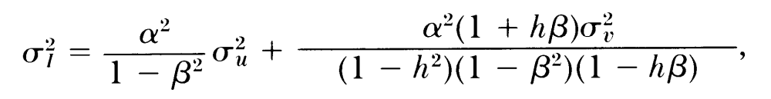
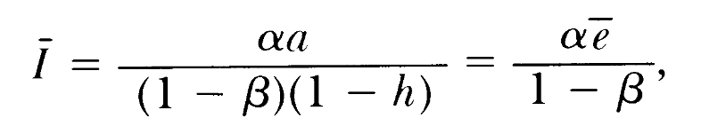
The equilibrium Inequality in Income
If ut, vt are independently distributed, the stationary variance is:
Since the expected value of both endowed and market luck equals zero, we have:
(1)
(2)

Slide 19
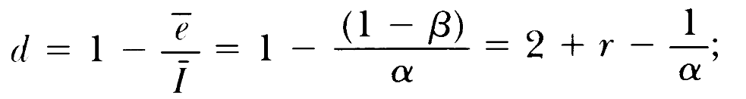
The equilibrium Inequality in Income
The fraction of I-bar contributed by investment is:
Positively related to r and α(fraction of family income invested in children)

Slide 20
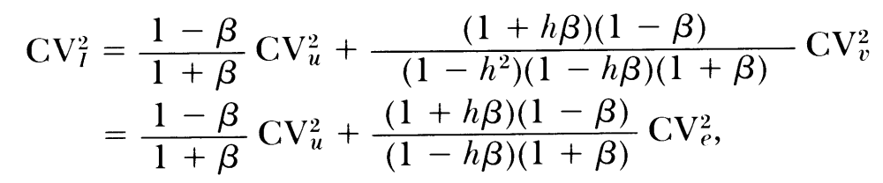
The equilibrium Inequality in Income
Since we normally use Gini coefficient or the coefficient of variation to measure inequality, we can divide (1) by (2), then
The square of the equilibrium coefficient of variation in income is

Slide 21
Intergenerational Mobility
Discusses two types of inequality in the same framework
Analyzes intergenerational mobility with the framework in previous sections
Shows the propensity to invest in children(β) and the degree of inheritability(h) are also important determinant of intergenerational mobility

Slide 22


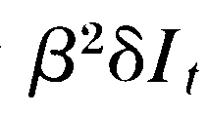

Intergenerational Mobility
If h is negligible=> equalibrium correlation coefficient = β
If h is not negligible => coefficient >β
Look at the sequence of changes in the income of parents( ), children( ), grandchildren( ) and later decendants
Income for the mth generation of decendents:
When h=0 , the amount decreases when β<1, close to zero after a few generations

Slide 23



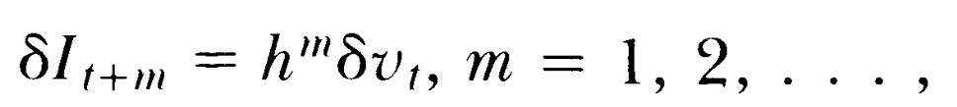
Intergenerational Mobility
If investment is given for each family, then we have the sequence of increase from the endowment for parents( ), to the income of children( ), grandchildren( )
mth generation of decendant:
When yt exogenous
the amount of increase decreases when h<1, close to zero after a few generations

Slide 24

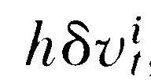
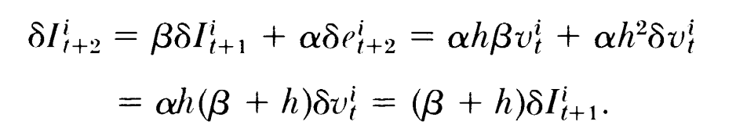
Intergenerational Mobility
If investments in children depend on family circumstances, also the degree of inheritability is not negligible
Eg: Endowment of luck increase of the i-th family in the t-th generation is compansated by a decline in market luck so that It remains the same, look at the endowment changes:
For children:
For grandchildren:
If β+ h >1, a compensated increase in the endowment of parents would increase the income of grandchildren by more than the income of children

Slide 25
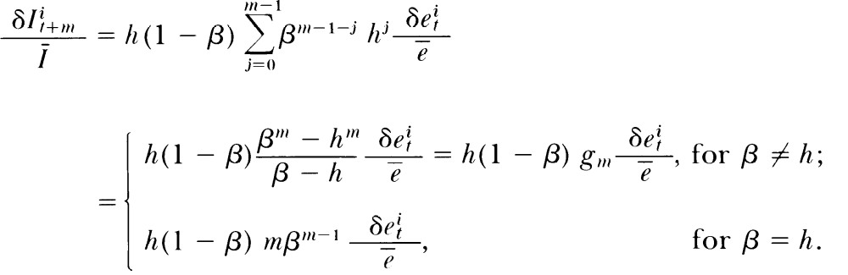
Intergenerational Mobility
Equalibrium level of average income of the m-th generation of decendant

Slide 26
gm is a symmetric polynominal in βand h

Slide 27
Intergenerational Mobility
The welfare of several consecutive generations of the same family would be closely linked whenever inheritability is not rigidly determined by the biology of human inheritance but is greatly influenced by social organization.
Closed Vs Open societies
The inheritability of endowments would be greater in closed societies.

Slide 28
Sections
Single Family
The equilibrium Inequality in Income
Intergenerational Mobility
Estimation of Family and Market Parameters
Heterogeneous Families
Government Redistribution of Income
Extensions

Slide 29
Summary & Conclusions
Key assumptions:
Each family maximizes a utility function spanning several generations
Utility depends on the consumption of parents and the quality(adult income) and quantitiy of their children

Slide 30
Summary & Conclusions
The income of children increases if they receive more human and nonhuman investment from their parents, endowment of genetically determined race, ability, other charactoristics, and “luck”
Parents maximizes utility subject to their income, the inherited endowments of children, and any anticipated endowment and market luck of children
The equilibrium income of children is determined by their market and endowed luck, the own income and endowment of parents, the degree of inheritability and the propensity to invest in children(*)
If all these parameters are less than unit, the distribution of income between families would approach a stationary situation.
Differences between families raises the inequality in income and strech out its distribution because these differences interact with income and luck

Slide 31
Comment
This paper provides a systematic analyse of the intergenerational mobility.
It models social problem by carefully setting up assumptions and using utility maximization.

Slide 32
Thank you!
---Hang Fu
April, 2014

